Slide 1
Prelim 1 Review
Prelim 1 Posting on Wednesday morning (Oct 16)
Due on Sunday 11 pm on Oct 20.

Slide 2
Turning in assignments
On campus: use Canvas
Off campus: continue using email

Slide 3
Test format
Prelim 1 CEE 4520 Fall 2019
Open book, open internet. Conversations with other students, TAs and with Monroe about this exam are allowed. You are not allowed to share exams or copy a solution from someone else. All short answer and coding must be in your own words.
The problem statements may contain more information than is needed.

Slide 4
Test format
What types of questions should we expect?
Short answer
Multiple choice questions
Design challenges
How far should we be able to extrapolate beyond what is in the notes?
You should understand the fundamental concepts and be able to talk about those concepts with your friends

Slide 5
Python based Prelim: What could fail?
Delete part of the exam by mistake
Google Colab crash
Dog eats your Laptop
Reduce the risk of failure
Save a copy with your name in the title as step 1
Save versions in more than one place! (in the cloud and on hardware you own)

Slide 6
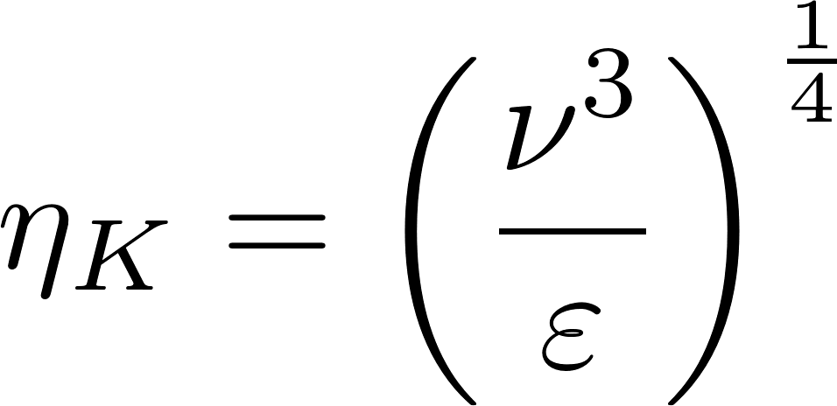
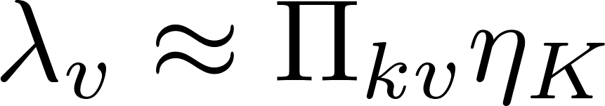
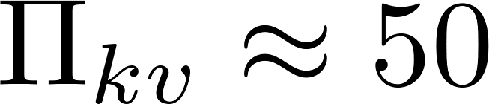
Rapid Mix
How do you calculate the Kolmogorov scale?
Do I need to worry about the rapid mix derivations section in textbook?
Chemistry (not required for CEE 4520)
This was meant to be a reference for many different types of flows and mixing processes with equations summarized in the intro
Kolmogorov length scale
Inner viscous length scale

Slide 7
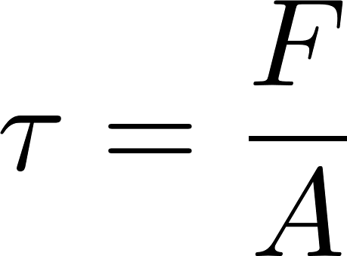
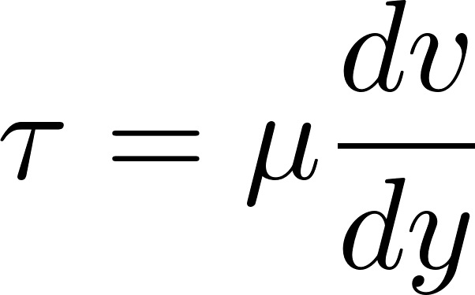
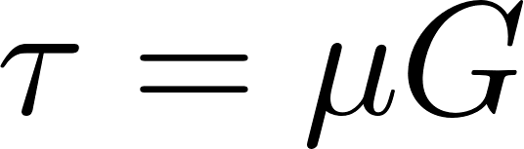

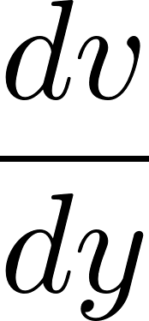

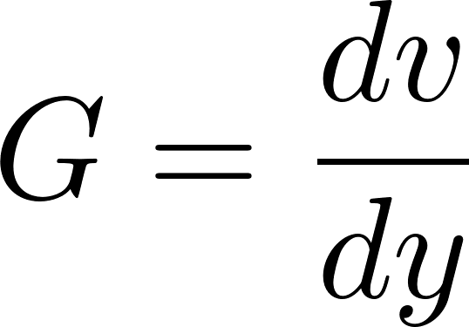
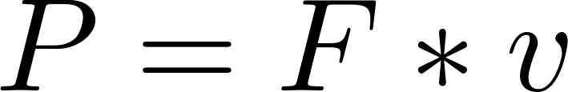
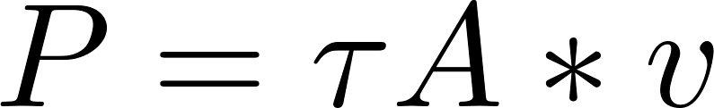
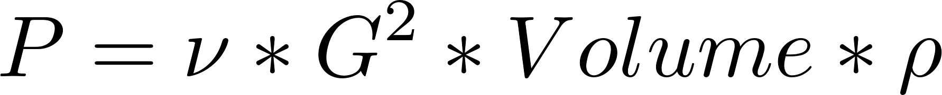

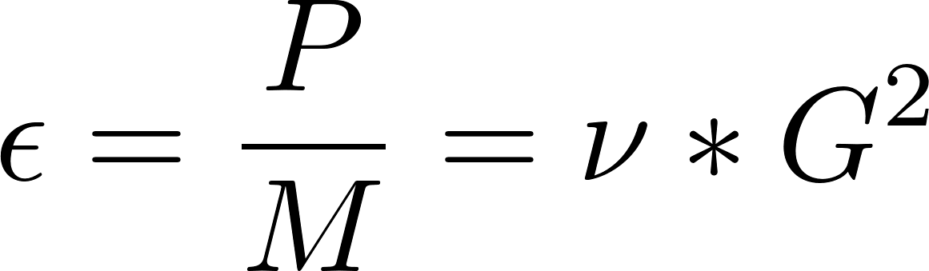
Can we go over the concepts of Gcs and ε again?
Exactly for the case when velocity gradient is uniform

Slide 8
Does Energy use of flocculation matter?
What is the ratio of energy required to efficiently flocculate vs the energy required to pump water to thousands of people's homes miles away? Although I understand the desire to optimize, I wonder how much it reduces costs.

Slide 9
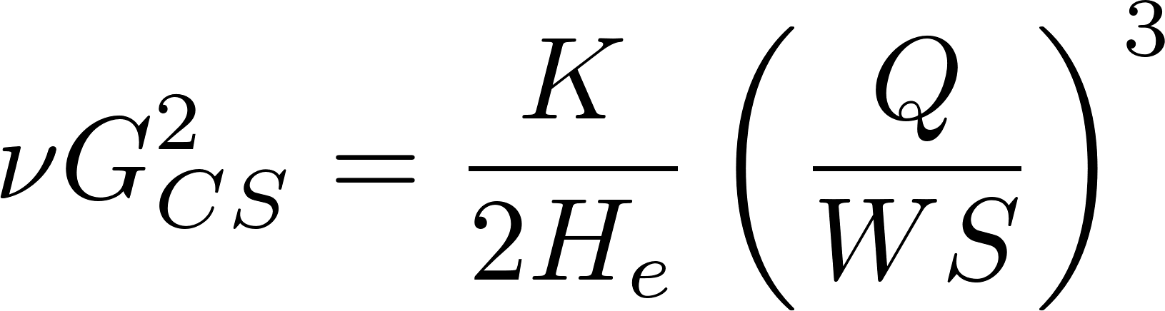
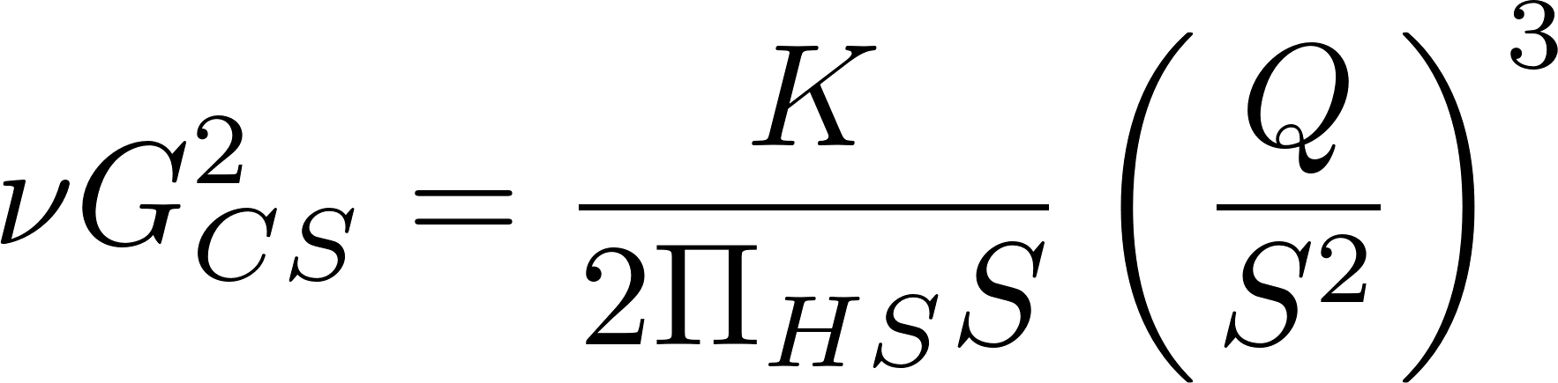
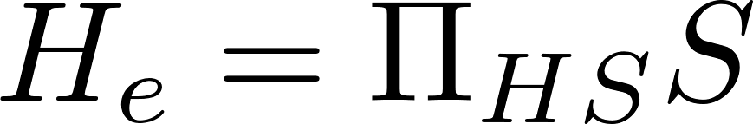
Bottom up Design
When would be an appropriate time to design a flocculator using bottom up approach?
Check a design to see if it is correct!
Optimal design with no layout constraints
Let W = S
Let He =
Solve for S!

Slide 10
Fractals
The fractal component of the terminal velocity equations are confusing to me.
I am confused about fractal geometry. How does it explain the changes in floc density and sedimentation velocity as a function of floc size? Why is it when the fractal dimension is greater than 1 the terminal velocity increases and floc diameter increases?

Slide 11
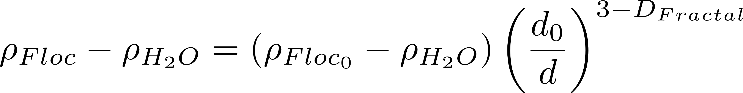
Buoyant Density of Flocs
Will these flocs settle faster than the primary particles?
Notes:
Here we assume that the primary particle (clay plus coagulant) is 1 micrometer in diameter.
The assumption is that we are starting with clay at 2650 kg/m^3.

Slide 12
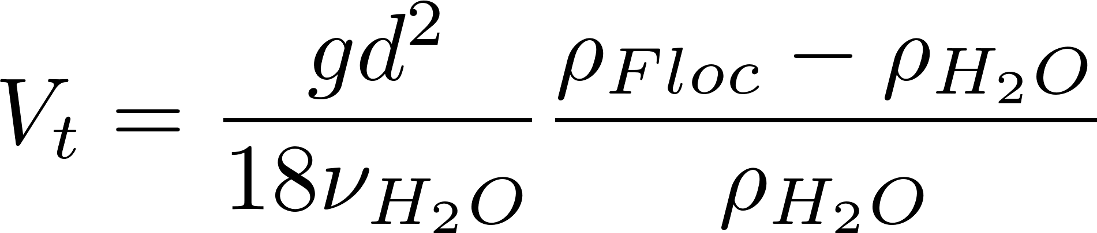
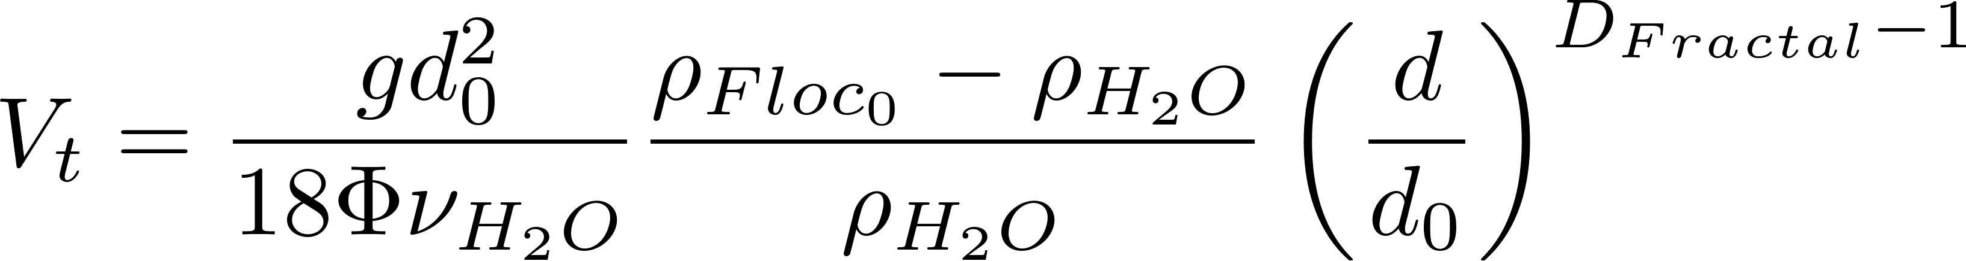
Floc Terminal Velocity
Laminar flow
Upflow velocity for floc blankets
Capture velocity for AguaClara plate settlers
Why flocculation is necessary!
1 μm
D_{Fractal} = 2.3 and d₀ = 1 μm
shape factor for drag on flocs
The model takes into account the changing density of flocs
Notes:
The shape factor adjusts the coefficient of drag for non spherical geometry and according to Tambo has a value of 45/24 for flocs (Tambo et al., 1979). This value is probably not yet well characterized. In any case it is expected to be order 1 because it is a correction to the drag coefficient due to shape.
All fractal dimensions greater than one are expected to increase the terminal velocity as the floc diameter increases.
Both floc blanket upflow velocity and plate settler capture velocity are AguaClara current design values, but are not optimized.

Slide 13
Coagulant dose
How does the LFOM change the chemical dosing?
How is coagulant dose chosen in response to flow rate through LFOM and other factors?
How will having an equation for the flocculation model help us to know how much coagulant should be added for a given turbidity.

Slide 14
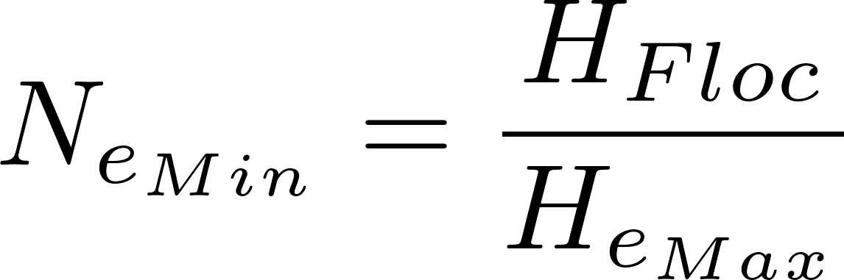
Flocculator elevations (as if it were one long channel)
Freeboard
Flocculator head loss
Water depth of sed tank inlet
S
We ignore triangle of fluid caused by head loss when calculating residence time
0.4S
H_{Floc}
S
S

Slide 15
Why is the AguaClara design so different from traditional designs?
Why lower G_{CS}θ?
Uniform velocity gradient
Close to plug flow (no short circuiting)
Why not tapered G_{CS}?
Why much higher G_{CS}?
Why can’t H/S be less than 2?
What is wrong with H/S greater than 6?
Notes:
Lower Gt because 1) more uniform 2) close to plug flow 3) floc blanket is next!
Tapered means less efficient use of energy. Tapered assumes that the goal is to make big flocs. That isn’t our goal.
We use a higher G so we can reduce the flocculator volume

Slide 16
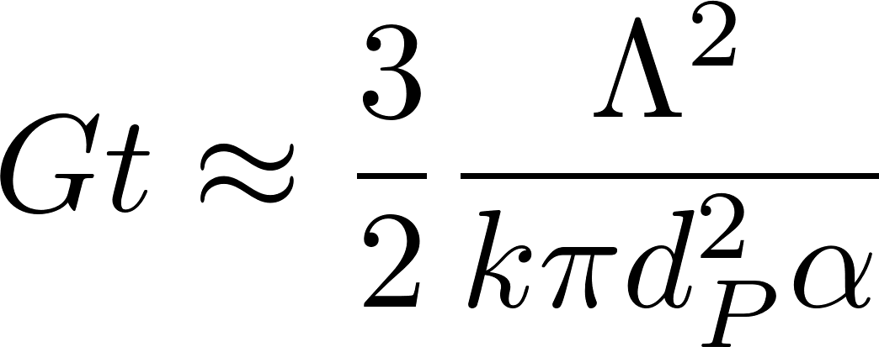
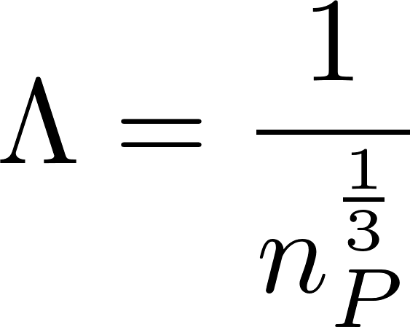
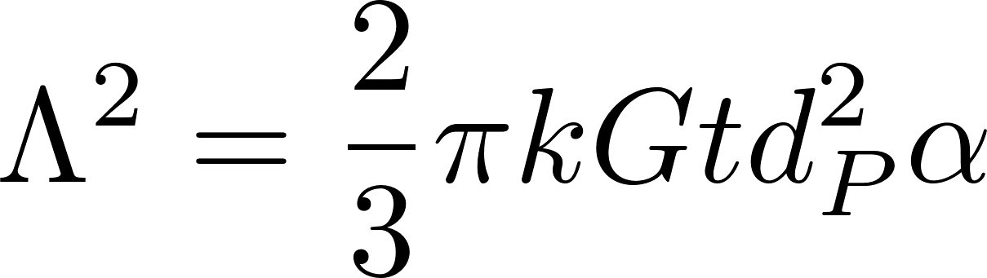
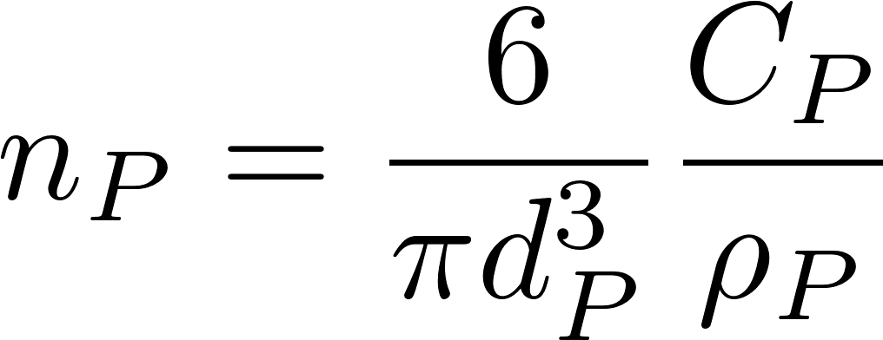
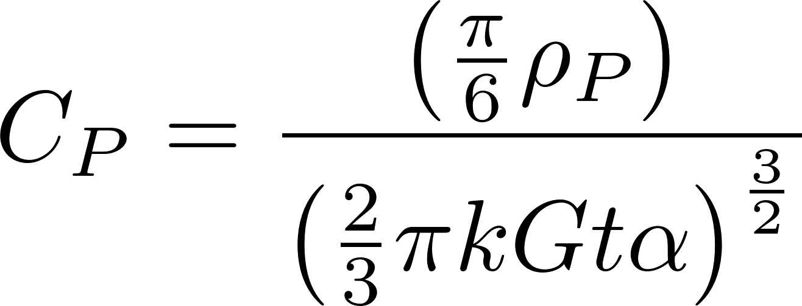
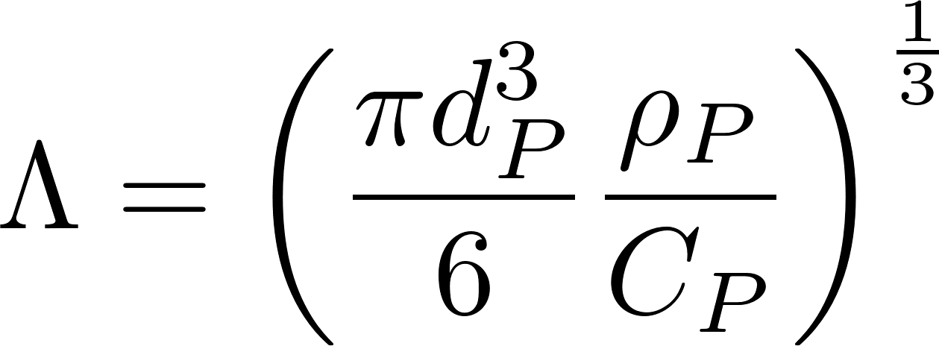
Primary particle concentration
k determined by William Pennock to have a value of about 0.03.
Clay diameter assumed to be 7 micrometer
68 NTU = 100 mg/L Kaolin clay
Coagulant nanoparticles = 90 nm in diameter

Slide 17
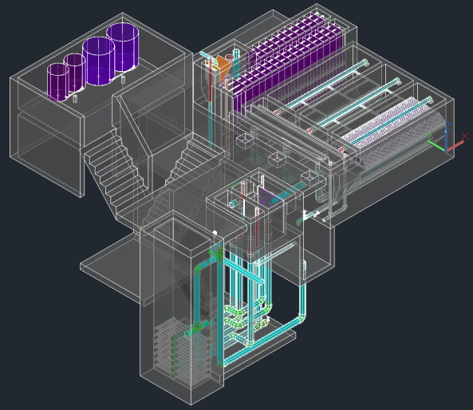

Slide 18
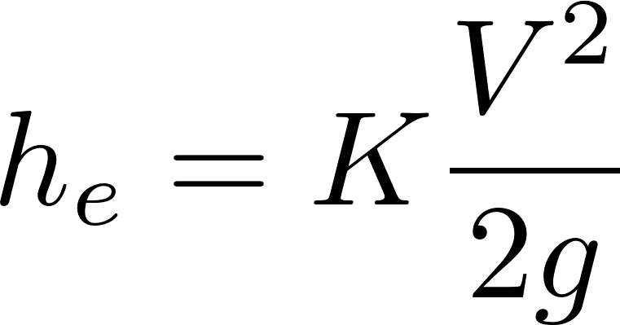
What are examples of major and minor losses?
Major: Caused by shear with the solid surface
Pipe walls
Flocculator baffle surfaces (insignificant)
Minor: Flow expansions (analogous to pressure drag)
Orifice, elbow, valve, any place where flow is expanding!
KE is converted into 2 things!
Velocity
Shear (wall on fluid)

Slide 19
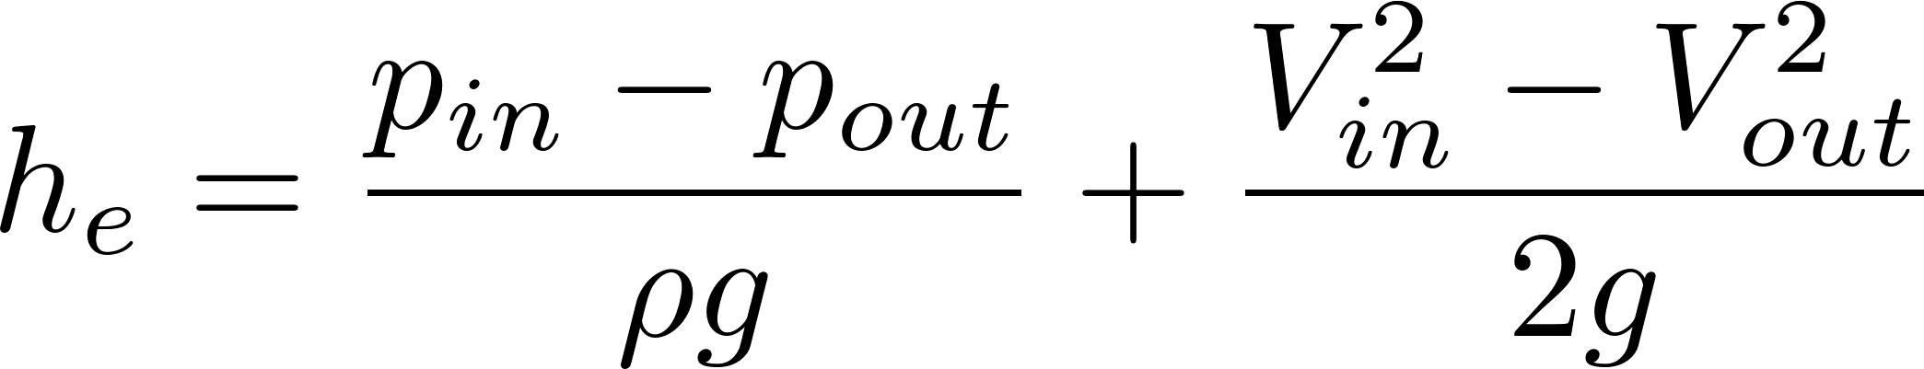
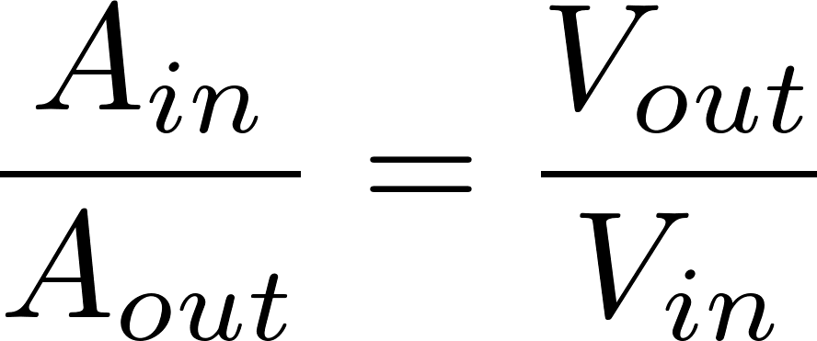
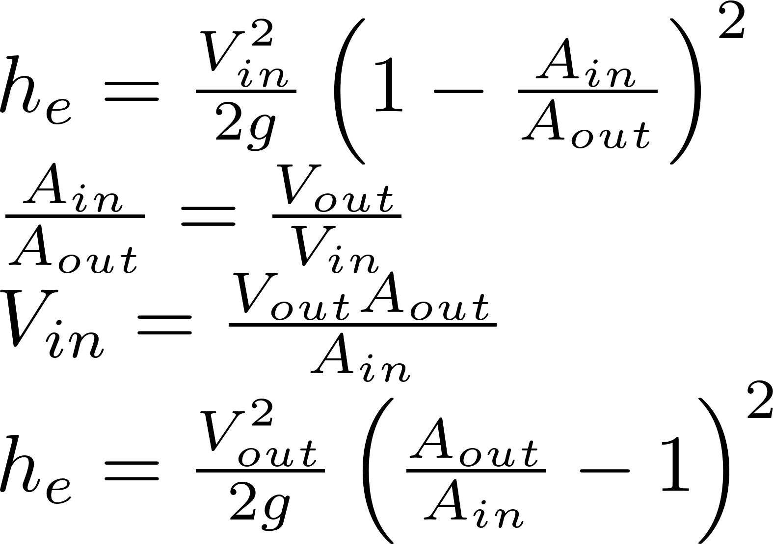
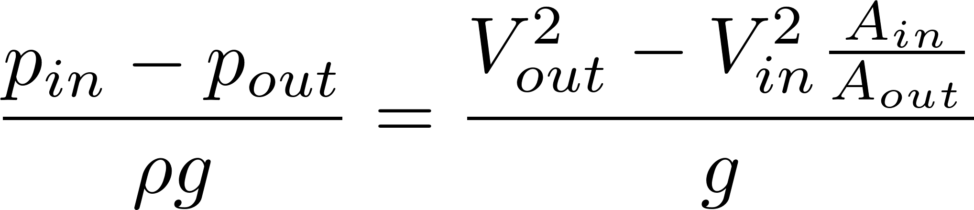
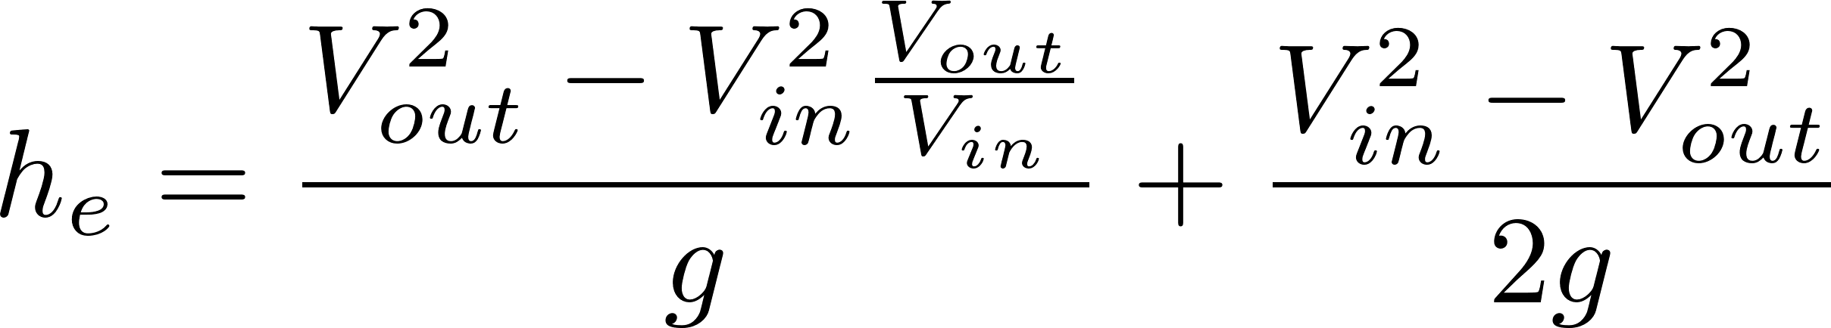
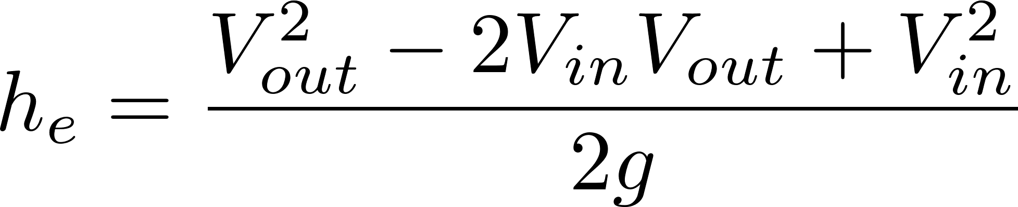
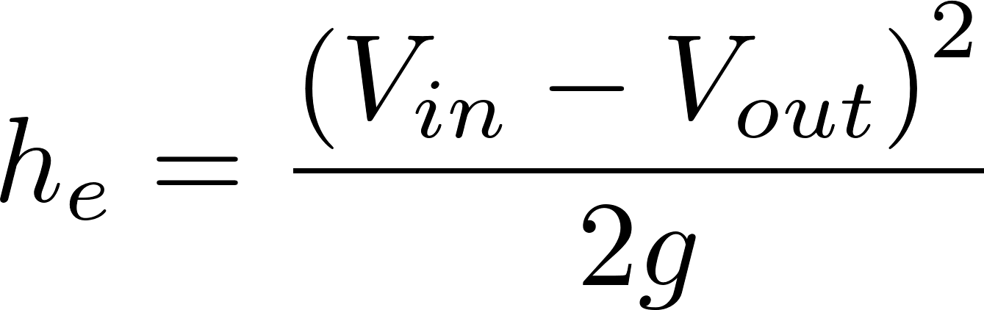
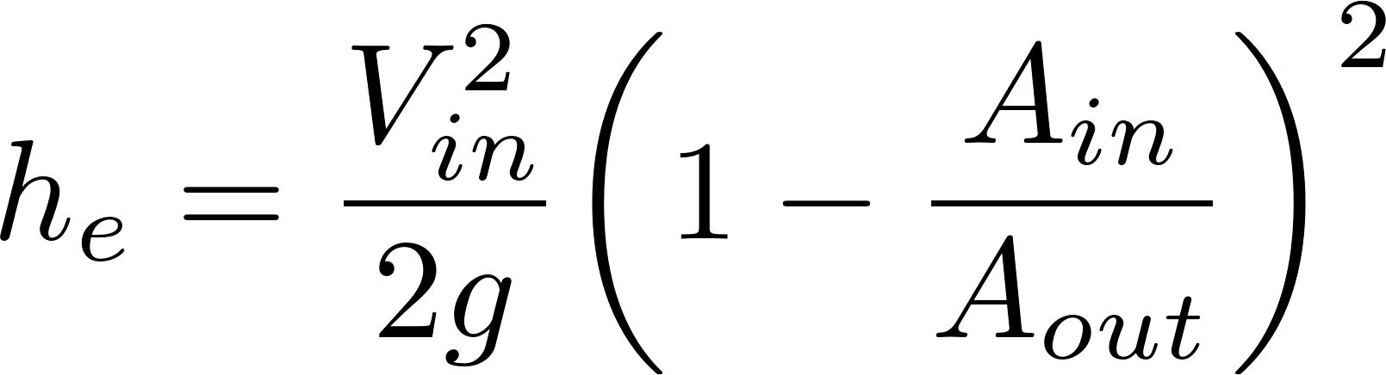
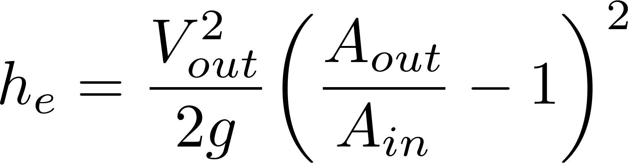
Head Loss due to Sudden Expansion
Energy
Mass
Momentum
2
2
2
K_{e}
K_{e}’
Discharge into a reservoir?__________________
Loss coefficient = 1
Notes:
Emphasize the minor loss coefficient is defined based on some relevant velocity. We can chose either V1 or V2. But the magnitude of the minor loss coefficient is determined by which velocity we use. We need to choose one and be consistent. The velocity that we choose will be a function of convenience. Minor losses are proportional to the square of the velocity. This is true whether the flow is turbulent or laminar!

Slide 20
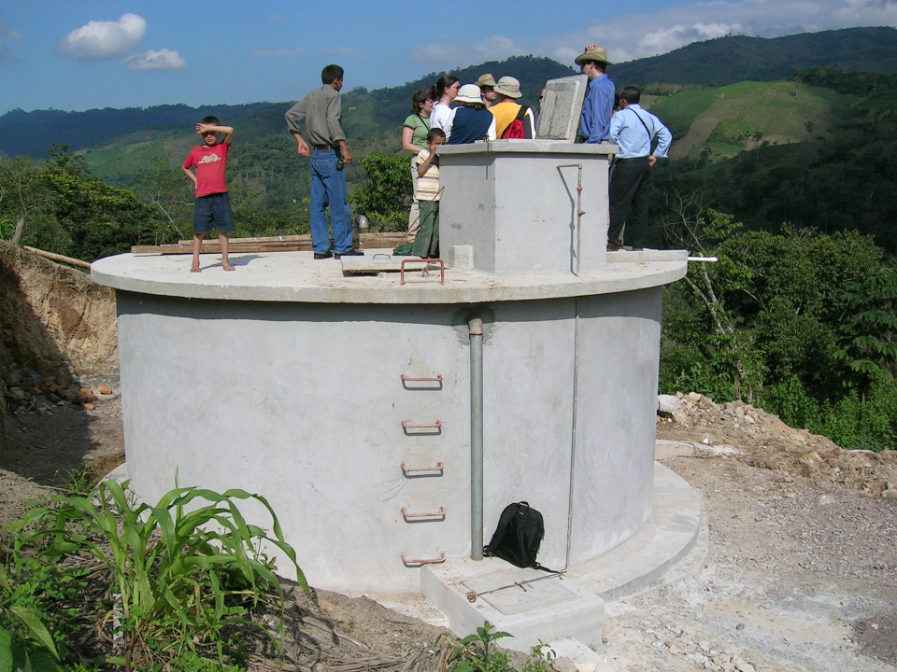

The Challenge of Chemical Metering (Hypochlorinator)
What is the simplest representation that captures the fluid mechanics of this system?
Access door to hypochlorinator tank
Overflow tube
Chlorine solution
Access door to distribution tank
PVC valve
PVC pipe
Chlorine drip
Raw water entering distribution tank

Slide 21
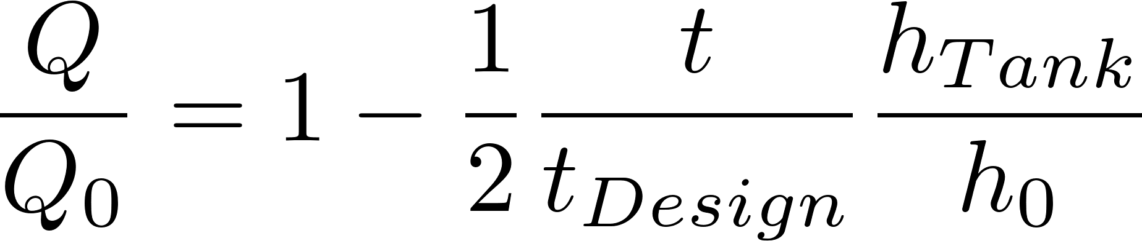
Hole in a bucket (tank drain)
What type of head loss (major or minor)?
What is the equation for those loses?
How would you calculate the initial flow rate given the minor losses?
How does the flow vary with time?
What is the average flow rate while the tank is emptying?
Notes:
Minor
Minor loss equation
Solve for V and note that Q=VA
Flow decreases linearly with time
Average Q is ½ of initial Q.

Slide 22
Hole in a bucket (tank drain)
Case 2, h₀=1 m, h_{tank} = 1 m, t_{design}=4 days

Slide 23
What happens if raw water temperature drops in a WTP?
Flow measurement
Chemical feed (air temperature?)
Rapid mix
Flocculation
Head loss through flocculator
Fluid deformation (Gθ)
Sedimentation – prelim 2!
Notes:
Flow measurement (no change in minor head loss)
Chemical feed (air temperature?) If stock chemicals chill, then increased viscosity gives lower chemical flow rate.
Rapid mix (both diffusion and fluid deformation will slow down)
Flocculation
Head loss through flocculator (no change)
Fluid deformation (Gθ) (decrease in G)
Sedimentation (decrease in sedimentation rate)

Slide 24
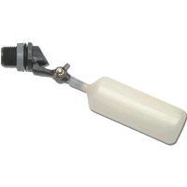
Constant head tank
Stock Tank of coagulant
Lever
Slider
H
Float valve
LFOM
Open channel supercritical flow
Drop tube
Float
Dosing tubes
Purge valves
Notes:
Why is Q vs depth of water linear for the entrance tank?
Why is Q vs H linear for the coagulant?

Slide 25
Decrease dose
H

Slide 26
Increase dose
H

Slide 27
Half flow
H

Slide 28
Plant off

Slide 29
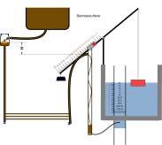
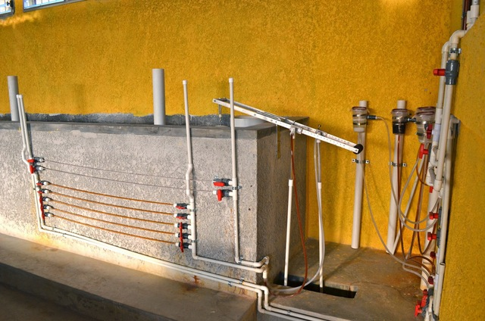
Where is this equipment in the new design?

Slide 30
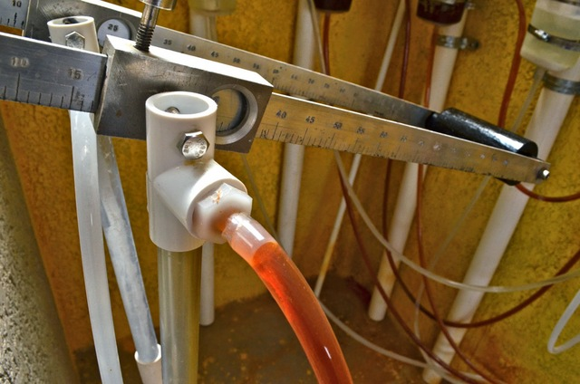

Slide 31
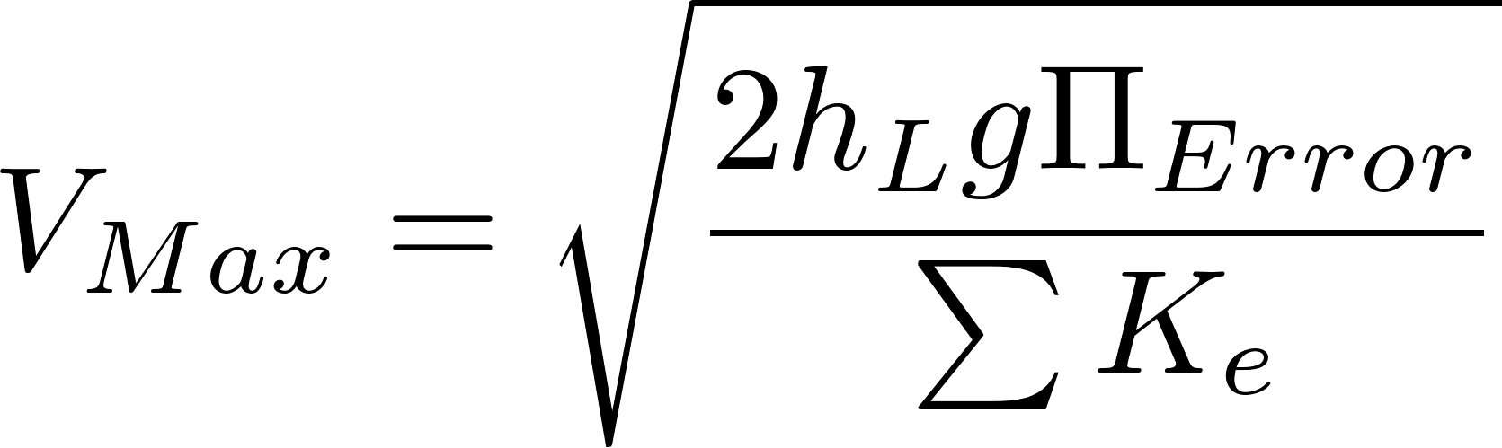
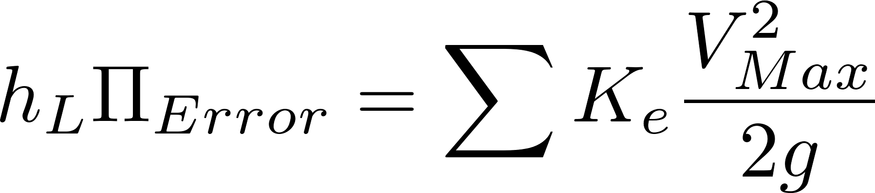
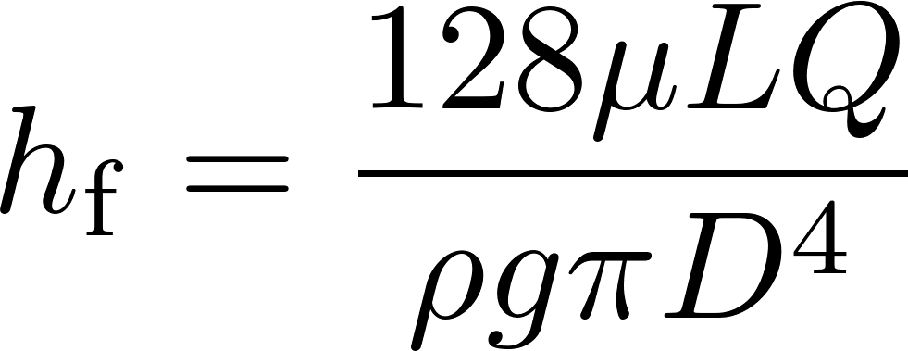
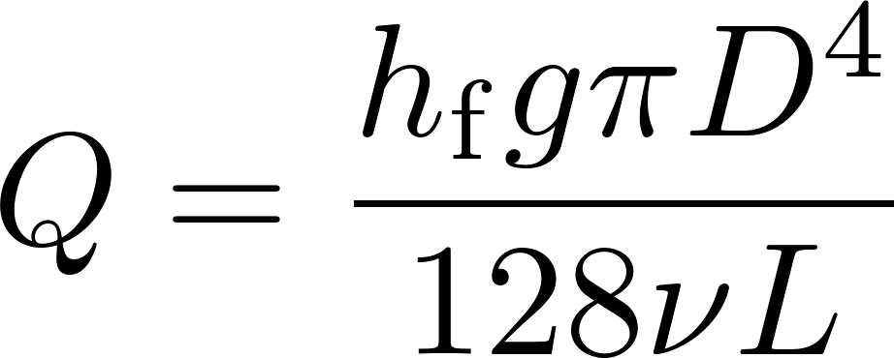
Chemical Dose Controller
What is the purpose of CHT?
What is the purpose of the dosing tubes?
What is the design constraint for the maximum flow rate in the dosing tubes?
Why does the flow through the dose controller increase if the plant flow rate increases?

Slide 32
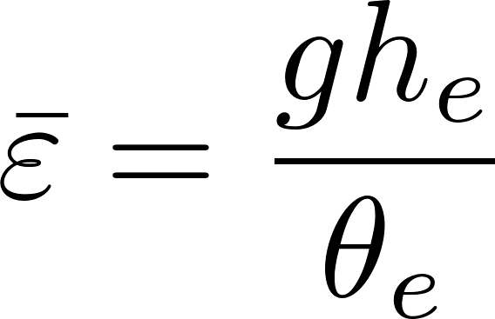
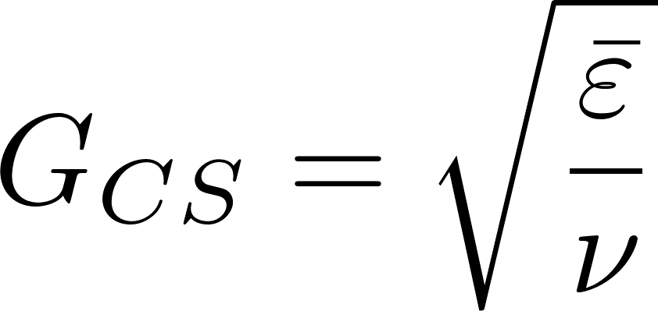
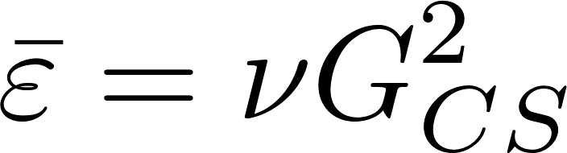
Head loss, energy dissipation rate, velocity gradient
See textbook!
Use these equations to relate velocity gradient to velocity (and then to flow geometry)

Slide 33
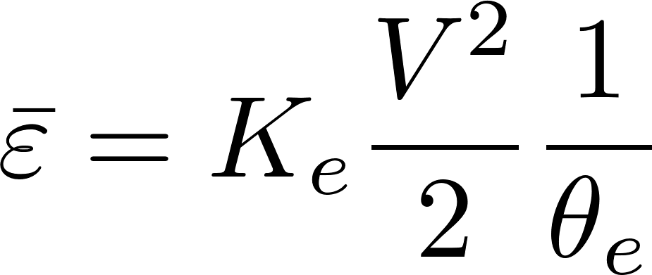

Energy dissipation rate
ε | Equation source | Equation | scale
Ave | Control volume mass momentum energy |  | time over which energy is dissipated
Max | Dimensional analysis |  | Flow dimension

Slide 34



Maximum Energy Dissipation Rate

Slide 35

Power and Energy
Energy: Joule = Newton*meter
Power: Watt = Joule/s
Water elevation change in an AguaClara plant is about 2 m. How much energy are we using per kg of water?
If the flow rate is 100 L/s, what is the equivalent power?
Desalination = 1 km, distillation = 250 km
2m*g = 19.6 (m/s)^2 = J/kg
Notes:
2m*g = 19.6 (m/s)^2 = J/kg
0.1m^3/s*1000kg/m^3*19.6J/kg = 1.9 kW

Slide 36



Identify all of the parameters in the Floc Model

Slide 37
Final Projects
1. create a plant design that can support a flow rate of 480 L/s 2.studying the removal of pesticides.
100+ L/s sedimentation tank without interior dividing walls
UV disinfection for replace chlorination
1. 100+ L/s sedimentation tank without interior dividing walls 2. 180+ L/s Flocculator
1. pesticide removal using activated carbon 2. Chemical Dose Controller (CDC) for flows above 100 L/s.

